Slide 1

Design and TCAD Simulation of MoS₂-Based FeFETs with HfO₂ Gate Oxide for Circuit Applications
ASGAR ALI M.Tech VLSI DESIGN
2024PVL0094
Department of Electrical Engineering IIT Jammu
Under the Guidance of: Dr.Chandan Yadav

Slide 2
Table of Contents
¹ Previous Work
² Literature Review of Current Work
³ TCAD implemented FeFET
⁴ Device Simulation and Results
⁵ Content-Addressable Memory (CAM) Cell
⁶ Search Operation Mechanics
⁷ Future Work
⁸ References

Slide 3
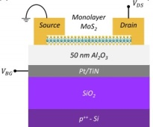
Previous Work – MoS2 Memtransistor
Objective: Implement an MoS2 channel memtransistor using an HfO2 dielectric.
Proposed Mechanism: Modulation of threshold voltage (V_{th} ) via charge trapping and detrapping at the dielectric interface.
Operation: Application of negative pulses for programming (detrapping) and positive pulses for erasing (trapping)
Methodology:Device structure created in SDE; DC transfer characteristics (I_{d} − Vg ) obtained in Sdevice.
Figure: 2D Back gated memtransistor[1]

Slide 4
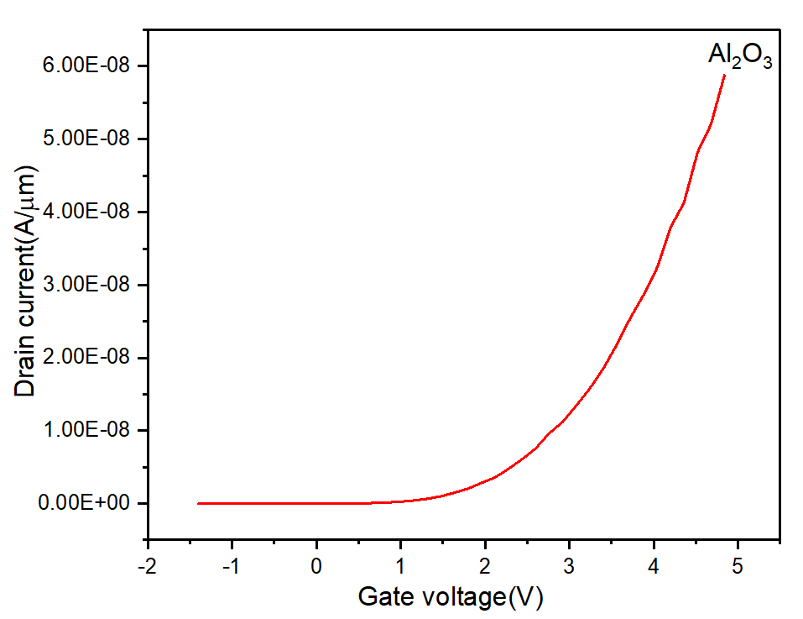
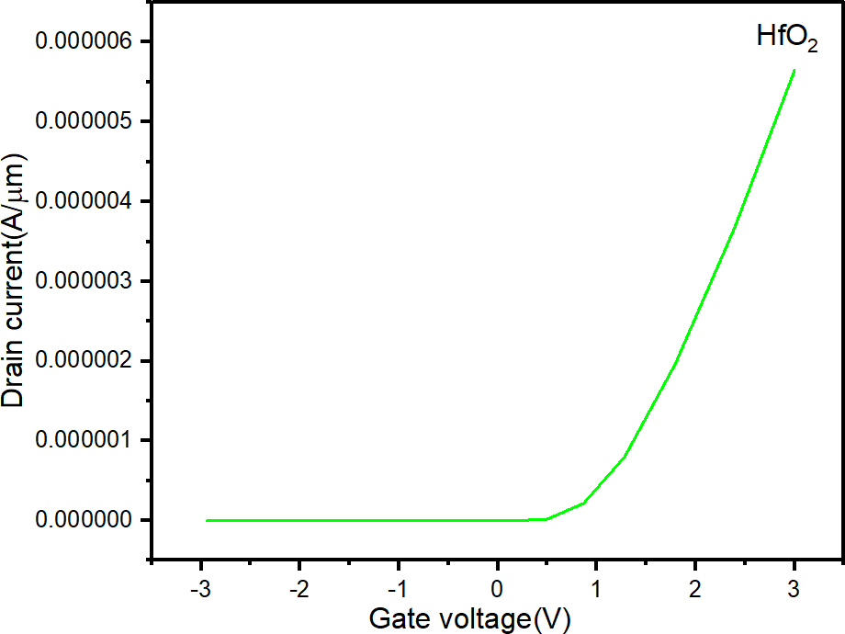
Previous work simulation
Simulation methodology
Simulation Limitations: While DC transfer characteristics (I_{d} − Vg ) were successfully obtained, replicating dynamic V_{th} shifts through pulse application proved computationally elusive in TCAD..
Modeling Complexity: The failure was caused by the difficulty of mimicking stochastic trapping behavior—governed by SRH dynamics and energetic trap states (E_{it} )—under short-duration pulses.
Quasi-Static Workaround: Shifted to a quasi-static approach, manually adjusting interface trap concentrations during DC simulations to analyze the resulting impact on current and V_{th} shifts.
Simulation results

Slide 5
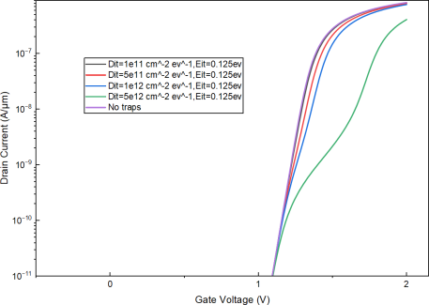
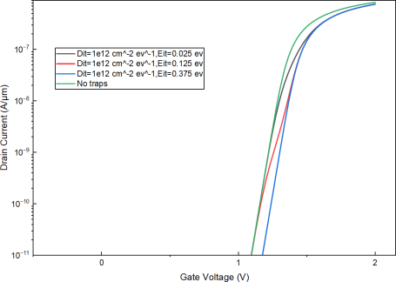
Previous work simulation
Interface trap concentrations(Dit) and interface traps energy level(Eit) variations
Figure: Ids vs Vgs Different Dit at 0.125eV
Figure: Id vs Vgs at different Eit while Dit is fixed(1e12/cm² .eV ¹ )

Slide 6
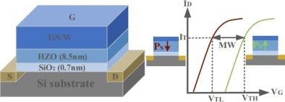
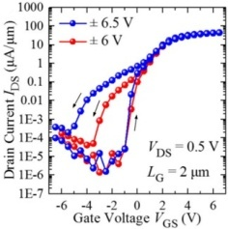
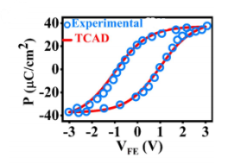
Literature Review of Current Work
Jianjian Wang et al., ”Effects of Charge Trapping on Memory Characteristics for HfO2-Based Ferroelectric Field Effect Transistors”, Nanomaterials (2023).[2]
Figure: Schematic structure ferroelectric field effect transistor (FeFET) devices and the transfer characteristic curves (ID-VG) under the opposite spontaneous polarization [2]
Figure: Polarization of two states of FeFET[2]
Figure: Id vs Vgs of two states of FeFET[2]
Polarization Mechanism: Data is stored via polarization reversal; a positive gate voltage induces downward polarization (Low-V_{T} state), while a negative voltage induces upward polarization (High-V_{T} state).

Slide 7
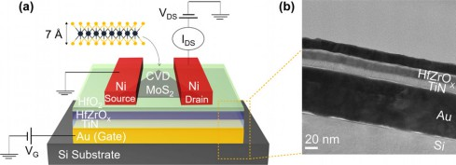
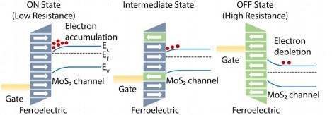
MoS₂-Channel FeFET
Reference: Pin-Chun Shen et al., ”Ferroelectric memory field-effect transistors using CVD monolayer MoS2 as resistive switching channel”, Applied Physics Letters (2020).[3]
Operation Physics: Positive gate bias aligns dipoles toward the MoS2, creating an electron accumulation regime and a Low Resistance State (LRS).
Figure: (a) Schematic diagram of a single-layer MoS2 FeFET. The gate stack is composed of an Au gate electrode, TiN, HfZrOx as the ferroelectric layer. (b) Cross-sectional view of a representative sample showing the structure and thicknesses of the gate stack.[3]
Figure: Energy band diagram of the MoS2 FeFET for different working states including a low resistive, intermediate, and high resistive states[3]

Slide 8
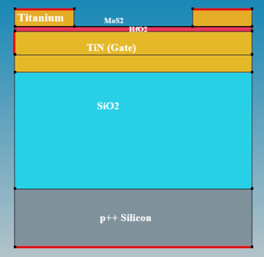
TCAD implemented FeFETs
Device Structure: A MOSFET with a ferroelectric layer (e.g., HfO2) embedded in the gate stack. .
Working Principle: Stores data as the physical orientation of electric dipoles.
Positive Gate Bias: Dipoles point toward the channel, accumulating electrons (Low − V_{th} state).
Negative Gate Bias:Dipoles point toward the gate, depleting the channel (High − V_{th} state).
Figure: 2D Device structure sde(Structural Setup (SDE): Monolayer MoS2 channel, 8
nm HfO2 ferroelectric, TiN gate, and Titanium S/D contacts.)

Slide 9
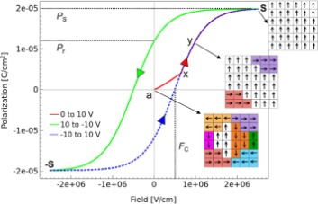
Device Simulation Results
TCAD Simulation Methodology
Structural Setup (SDE): Monolayer MoS2 channel, 8 nm HfO2 ferroelectric, TiN gate, and Titanium S/D contacts.
Physics Models (Sdevice):
Polarization: Preisach Model for HfO2 hysteretic behavior. Physics (Material= ”HfO2”) Polarization
Remanent Polarization (Pr ): The polarization that remains in the HfO2 layer after the external electric field is removed.
Saturation Polarization (Ps ): The maximum polarization level achieved .
Coercive Field (Fc ): The critical electric field intensity required to switch the dipole direction.
Dynamic Parameters: Uses specific relaxation times τ_{E} = 1 × 10⁻⁹ s and τ_{P} = 0 s to control the temporal switching response during pulse applications
Parameter | HfO2 Device
Pr | 10–30 µC/cm²
Ps | 20–50 µC/cm²
Fc | 1–2 MV /cm
τ_{E} | 1 × 10⁻⁹
Electrical parameters of the HfO2 device [2]
Fig:Polarization vs Gate Voltage[5]

Slide 10
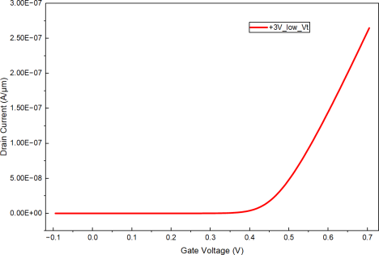
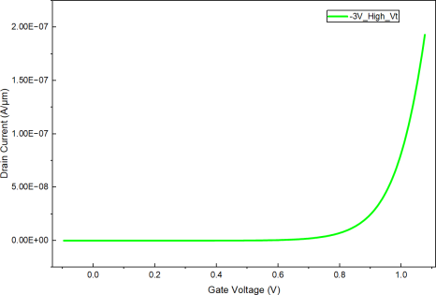
Ferroelectric Simulation Results
IdVg characteristics for +3V(Low Vt) and -3v (High Vt) state:
Figure: IdVg for +3v Low Vt State
Figure: IdVg for -3v High Vt State

Slide 11
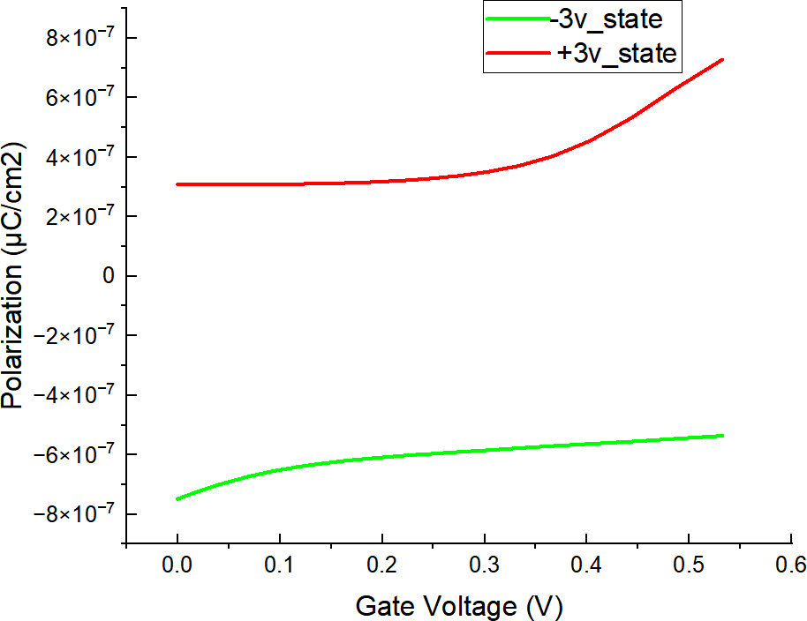
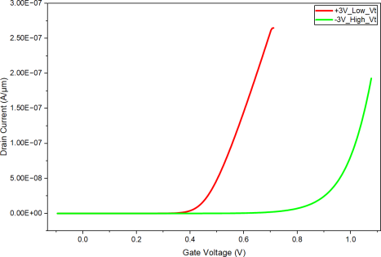
Vth shift and Polarization simulation results
Figure: IdVg for +3v and -3v pulse state
Figure: Polarization vs gate voltage for +3v and
-3v states

Slide 12
From Device Simulation to Circuit Application
The MoS2-based FeFET device exhibits two stable threshold voltage states (Low Vth and High Vth) due to polarization switching.
These two Vth states are utilized at the circuit level to implement a CAM cell, enabling storage of logic ‘0’ and ‘1’ using two FeFET devices.
Device Simulation |  | Circuit Simulation (Mixed Mode)
MoS2 based FeFET Device |  | Content Addressable Memory Cell (CAM)
Device working at two V_{th} Low V_{th} and High V_{th} |  | CAM cell Write 0 and Write 1 Using two FeFET devices

Slide 13
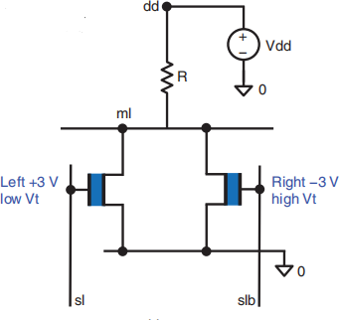
Content-Addressable Memory (CAM) Cell
Introduction to CAM Cells
Definition: Provide the data and memory will tell you that if it has data and where it is .
Architecture: 2-FeFET cell.
Key Circuit Element (R_{dd} ): A 1 MΩ pull-up resistor connected to the Match Line (ml).
Function of R_{dd} : Manages Match Line pre-charge/discharge; if a mismatch conducts, R_{dd}
limits current while ml voltage drop.
Figure: CAM Cell [5]

Slide 14
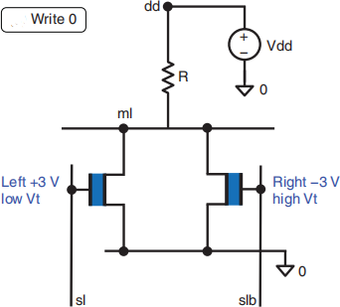
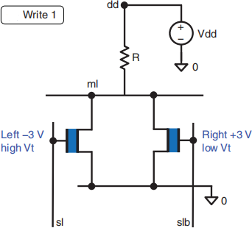
CAM Cell Operations (Write 0 and Write 1)
Write Logic ’0’:
Left FeFET: +3 V pulse (sets to Low − V_{th} ). Right FeFET: -3 V pulse (sets to High − V_{th} ).
This results in down polarization for the left FeFET (except at the gate edges) and up
polarization for the right FeFET.
Write Logic ’1’:
Left FeFET: -3 V pulse (sets to High − V_{th} ). Right FeFET: +3 V pulse (sets to Low − V_{th} ).
Before the application of pulse inputs, ml stays high as both FeFETs are in the offstate.
With the application of pulse inputs, the low-Vt FeFET is switched on, and ml discharges.
Figure: Write logic 0 [5]
Figure: Write logic 1[5]

Slide 15
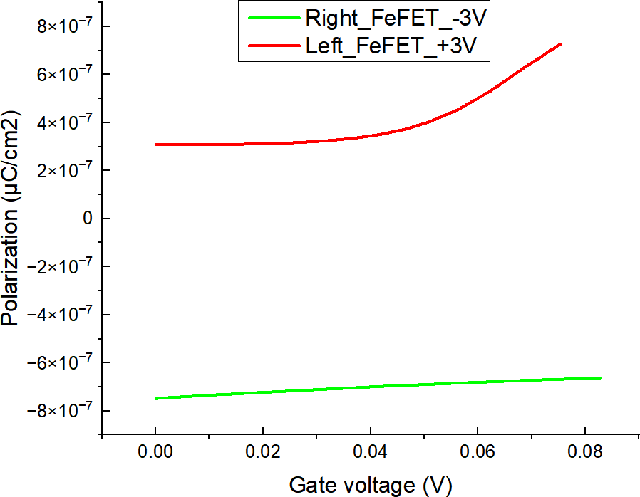
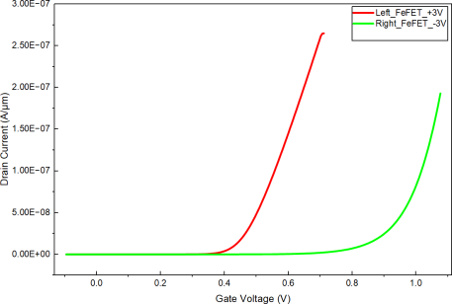
CAM Cell Simulation Result
Write Logic 0:
Figure: Ids vs Vgs linear scale post program state
Figure: Id vs Vgs log scale post program state

Slide 16


CAM Cell Simulation Result
Write Logic 1:
Figure: Ids vs Vgs linear scale post program state
Figure: Id vs Vgs log scale post program state

Slide 17
Search Operation Mechanics
Search :is used to perform massively parallel pattern matching in a single clock cycle.
Mechanism: Apply search voltage Vr = 0.6 V to complementary search lines (SL/SLB).
Match Condition: Input matches stored bits → Both FeFETs stay OFF → ML remains HIGH.
Mismatch Condition: Input differs → One FeFET turns ON → ML discharges to ground (LOW).
.

Slide 18
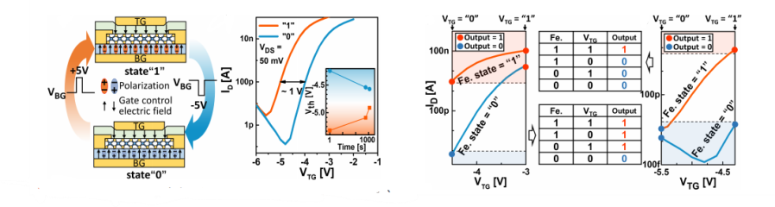
Future Work
Transition to HZO: Changing HfO2 to Hf0.5Zr0.5O2 (HZO). HZO has a lower crystallization temperature (400◦C), improving compatibility with 2D MoS2.
Proposed Architecture: Implementation of a Ferroelectric Embedded Dual-Gate (FEDG) FET, featuring a Top Gate for logic input and a Back Gate (with HZO) for memory storage.[4]
This configuration allows logic functions (e.g., AND/OR) to be implemented within a single transistor by combining the non-volatile memory state with active logic inputs.
Figure: Left to Right:) Schematic drawing of the electrical field and polarization of the device in two different states,) Top-gate transfer characteristics of the device after different voltage pulse on the back-gate,Demonstration of FeFET with logic “and”, Demonstration of FeFET with logic “or”. operations[4]

Slide 19
References I
[1] Zheng, Y., Ravichandran, H., Schranghamer, T.F. et al. Hardware implementation of Bayesian network based on two-dimensional memtransistors. Nat Commun 13, 5578 (2022). https://doi.org/10.1038/s41467- 022-33053-x
[2] Wang, J.; Bi, J.; Xu, Y.; Niu, G.; Liu, M.; Stempitsky, V. Effects of Charge Trapping on Memory Characteristics for HfO2-Based Ferroelectric Field Effect Transistors. Nanomaterials 2023, 13, 638. https://doi.org/10.3390/nano13040638
[3]Pin-Chun Shen ,Chungwei Lin,Haozhe Wang, Koon Hoo Teo, Jing Kong”Ferroelectric memory field-effect transistors using CVD monolayer MoS2 as resistive switching channel”.Appl. Phys. Lett. 116, 033501 (2020). https://doi.org/10.1063/1.5129963
[4] K. Huang et al., ”Hf.Zr.O Ferroelectric Embedded Dual-Gate MoS Field Effect Transistors for Memory Merged Logic Applications,” in IEEE
Electron Device Letters, vol. 41, no. 10, pp. 1600-1603, Oct. 2020, doi: 10.1109/LED.2020.3019681. keywords: Molybdenum;Sulfur;Field effect transistors;Logic gates;Memory management;Fabrication;Electric fields;MoS;ferroelectric;HZO;dual-gate;memory merged logic;in memory computing

